Slide 1
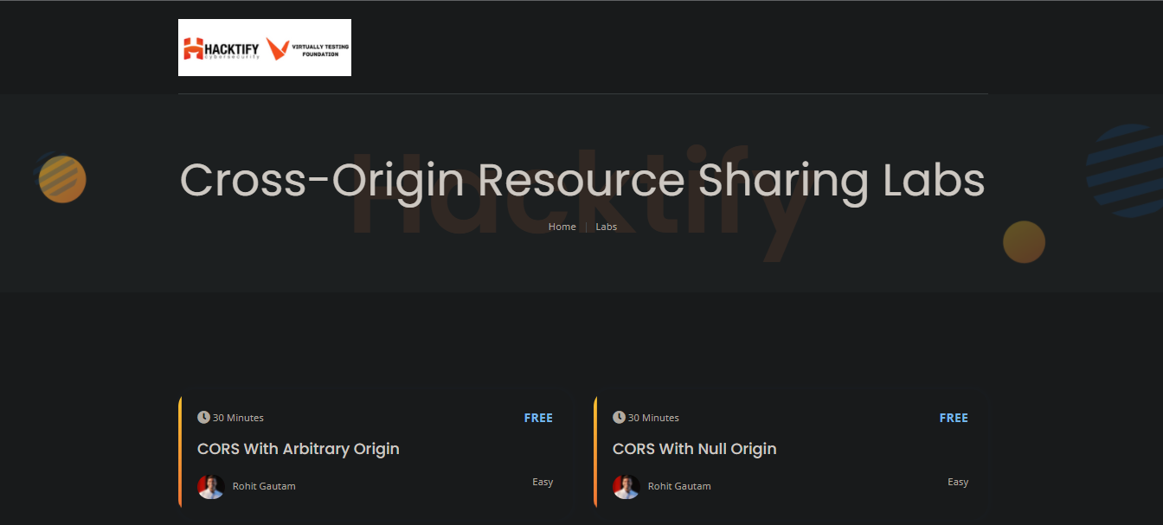
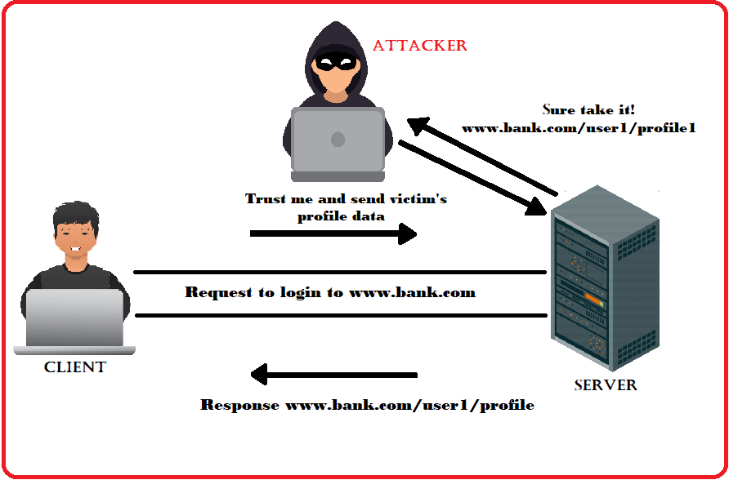

Week 5 as a Penetration Testing Intern
Cross-Origin Resource Sharing (CORS)
How CORS works?
Exploiting CORS
Severity of CORS
Impact and prevention of CORS
Cross-Origin Resource Sharing
Virtually Testing Foundation

